Slide 1
Spheroids

Slide 2
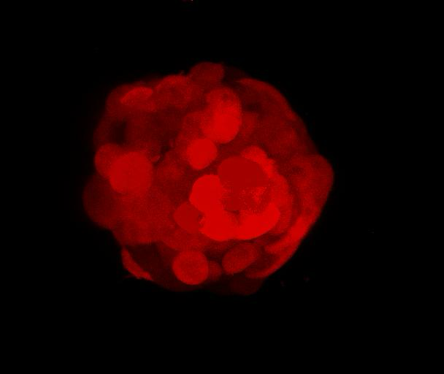
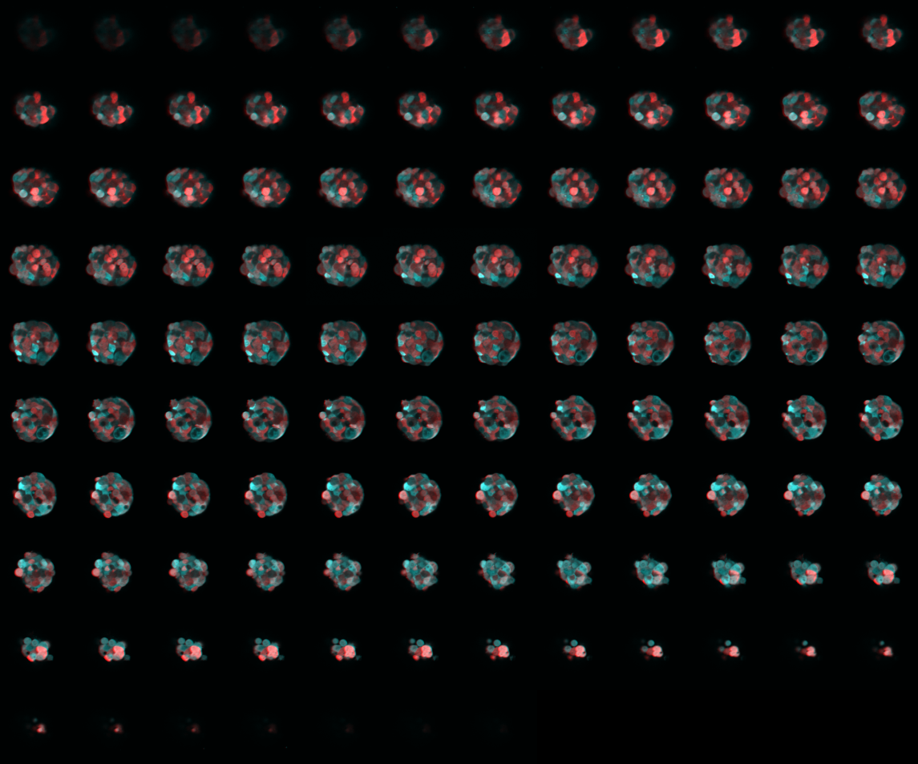
Raw Data example

Slide 3
Goal
Analyze noise in segmented spheroid

Slide 4
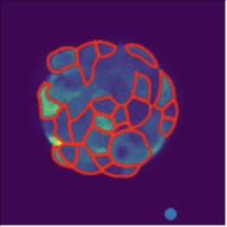
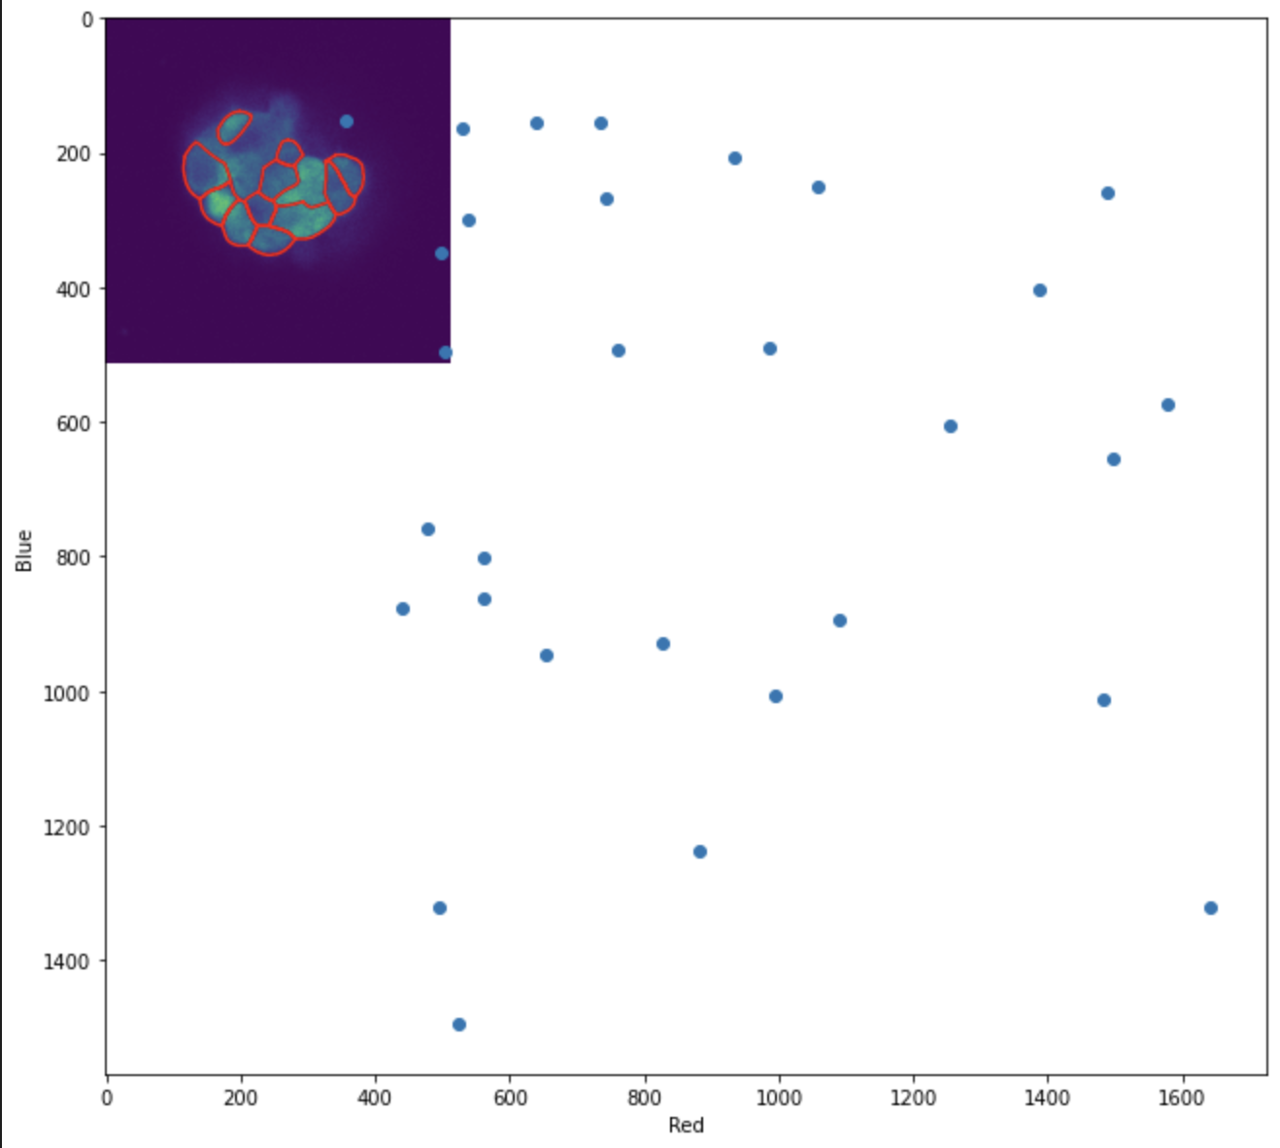
Process
Segment
Calculate mean for each segmented cell
Scatter plot for visualization
Intrinsic and extrinsic noise calculation

Slide 5
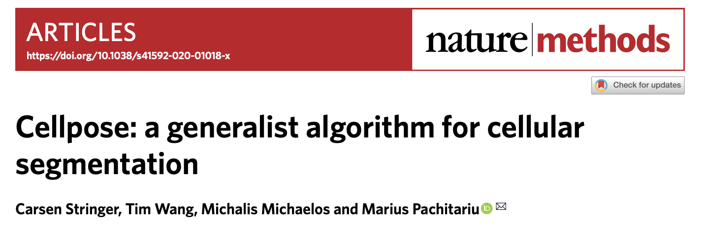
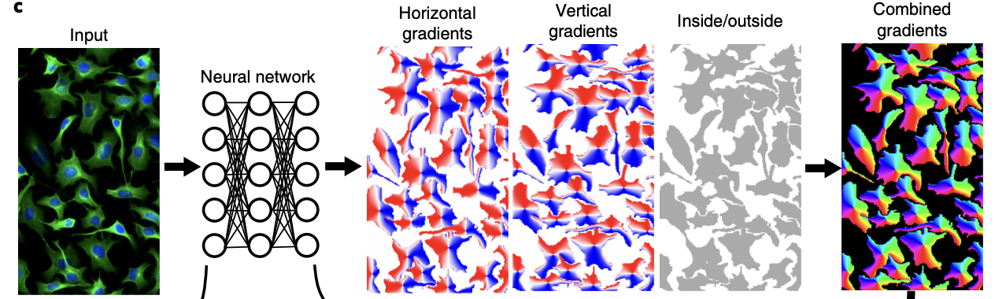
Segment
Cellpose algorithm
Outputs the boundaries of different cells

Slide 6
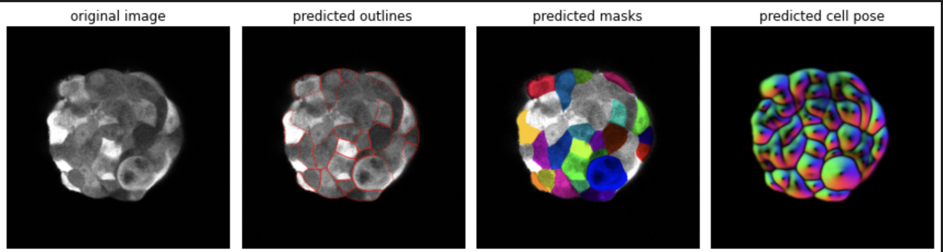
Segment
Cellpose algorithm
Outputs the boundaries of different cells

Slide 7
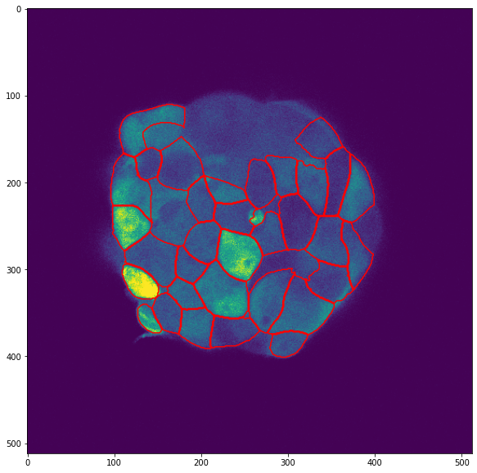
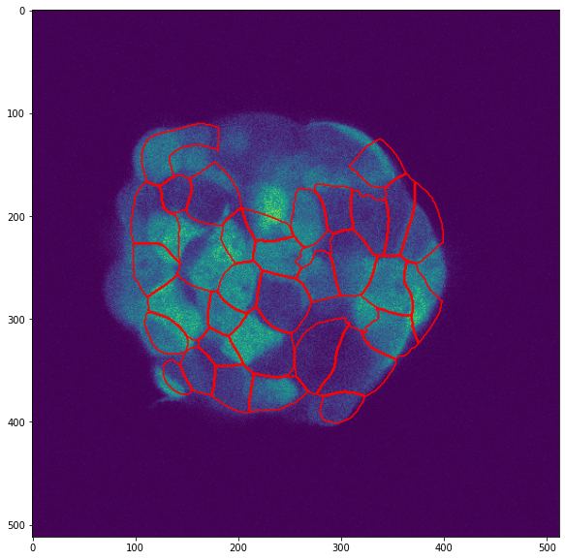
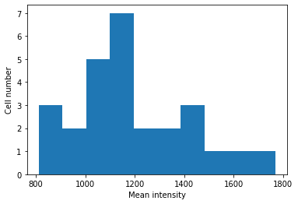
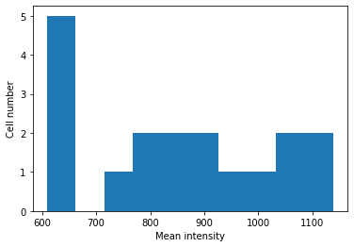
Calculate mean for each segmented cell
Notes:
Blue left, red right

Slide 8
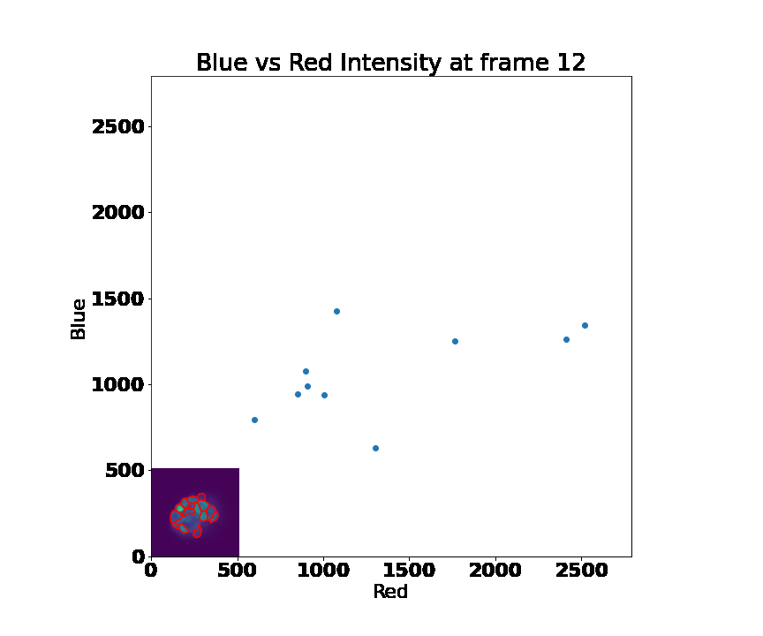
Scatter plot for visualization

Slide 9
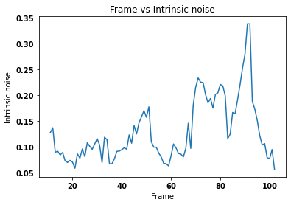
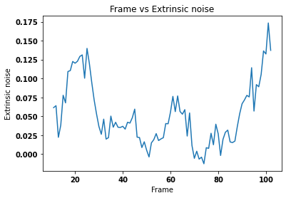
Intrinsic and extrinsic noise calculation
Notes:
The ends of the extrinsic noise being high could be because the segmentation is circling ones that are all black as well as the middle one with high expression.

Slide 10
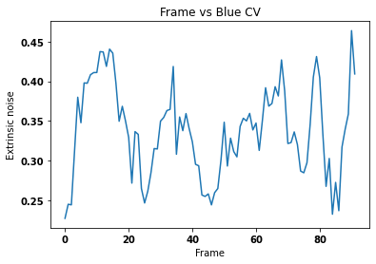
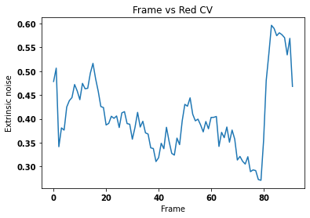
CV of expression vs Frame

